Slide 1

EMC²
Documentum

Slide 2
BMS Overview
Who we are
Business Management Systems is a company for information technology, providing full-scope solutions for business process automation.
Business Management Systems has a highly qualified team of professionals, with an extensive experience in implementation and maintenance of IT solutions.

Slide 3

BMS’ Systems for business management
SAP
Enterprise Resource Planning.
Management of Logistics, Finance, Accounting, Controlling
Documentum
Management of Documents
Hermes
Management of Human resources and payroll
CA
Service Desk Manager
Management of Services Quality
Business

Slide 4
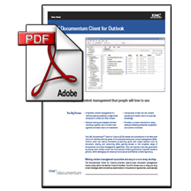





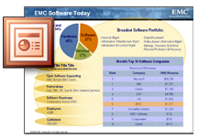

Documentum Documents Management System
Document management
Imaging
Records Management
Knowledge management
Workflow management
Collaboration
Transparency during business execution

Slide 5

Documentum Documents Management System
Our Goal
To achieve effectiveness
and quality of the
provided IT
service according
the international and company
standards.

Slide 6
Documentum Documents Management System
While we
guarantee…
Security, version control,
liability for every single
document in the system.

Slide 7
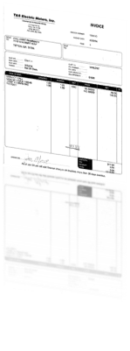

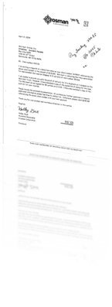

Documentum Documents Management System
Incoming documents
Exit
Finances
Contracts
Correspondence
Documents arriving in the company (snail mail) or electronically (fax/Email)
Outgoing documents
EMC Documentum
Input
Orders
Memorandum
Correspondence
Documents are created and maintained electronically throughout a fax server.
7

Slide 8


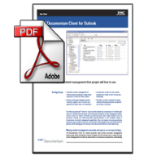
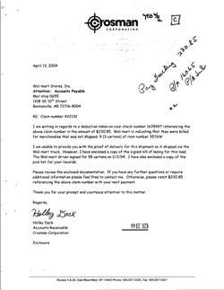






Documentum Documents Management System
Entrance
Registration
form
Scanning
Reg. card
+ image
ЕDocument
Reg. card:
Metadata
Author
Data
Location
Title
Contractor
All hardcopy documents are archived straight after the scanning.
All possible actions with the documents: review, approve, signature and etc., are maintained only electronically.
ARCHIVE
8

Slide 9


Documentum Documents Management System
No hardcopy documents
Organization 1
Organization 2
There should be an agreement between the two organizations for using electronic “no hardcopy documents policy!”
9

Slide 10
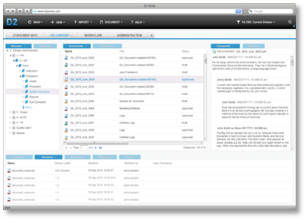
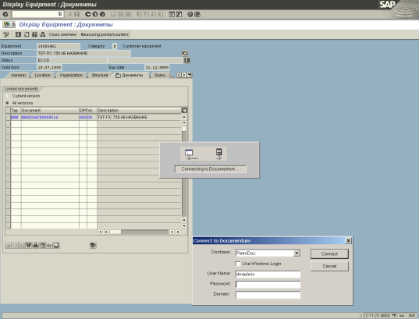
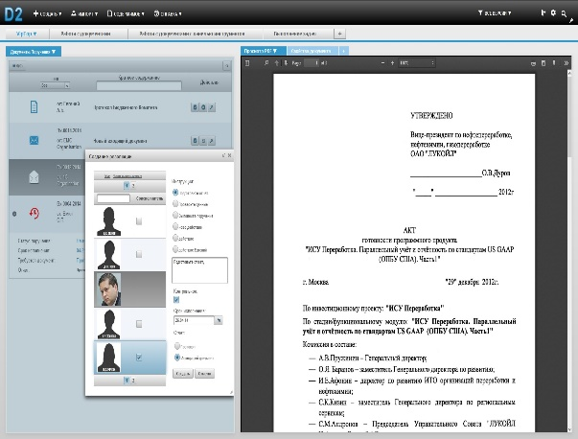
Documentum Documents Management System
Functionalities:
Electronic enterprise archive
Organizational distribution of document flow and correspondence
Financial document flow – sales, delivery, SAP integration
Appraisal and storage of contracts, SAP integration
Other processes for management of corporate documents
10

Slide 11
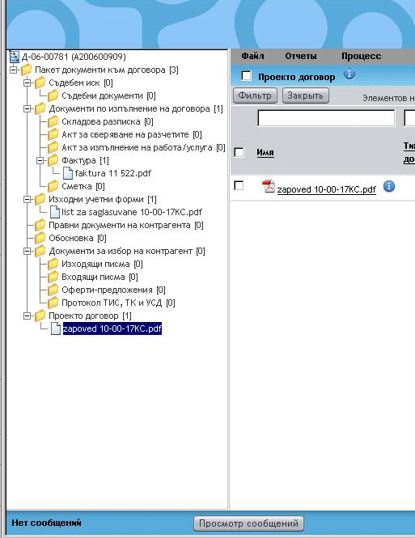
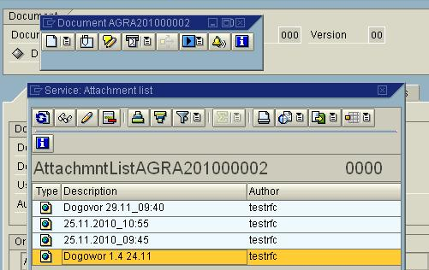
Documentum Documents Management System
There is a full integration with SAP.
The processes are running on both systems.
11

Slide 12
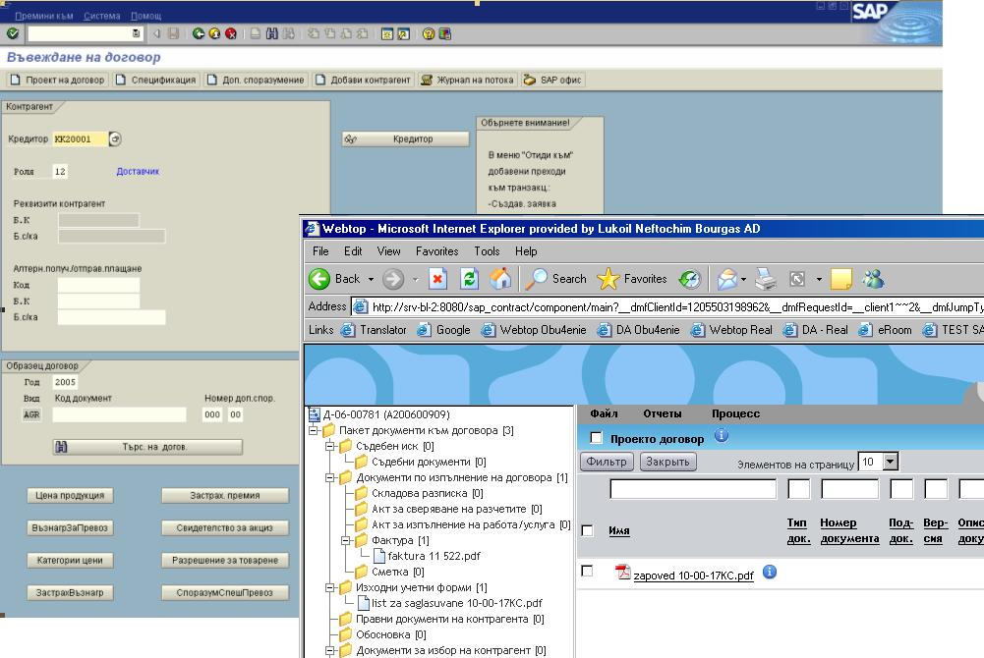
Documentum Documents Management System
Appraisal and storage of contracts – SAP integration
12

Slide 13
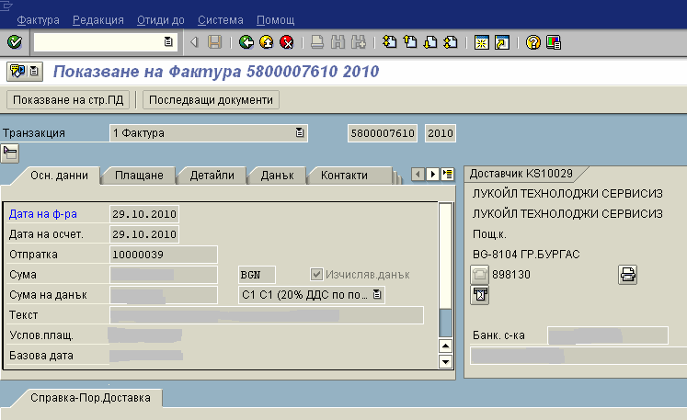
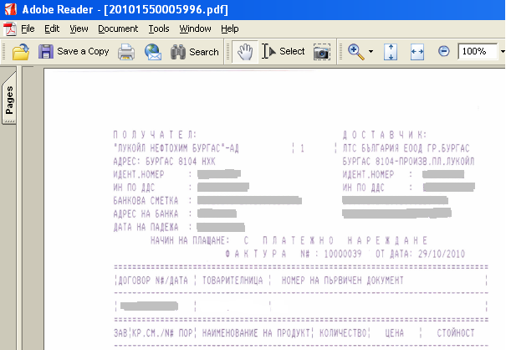
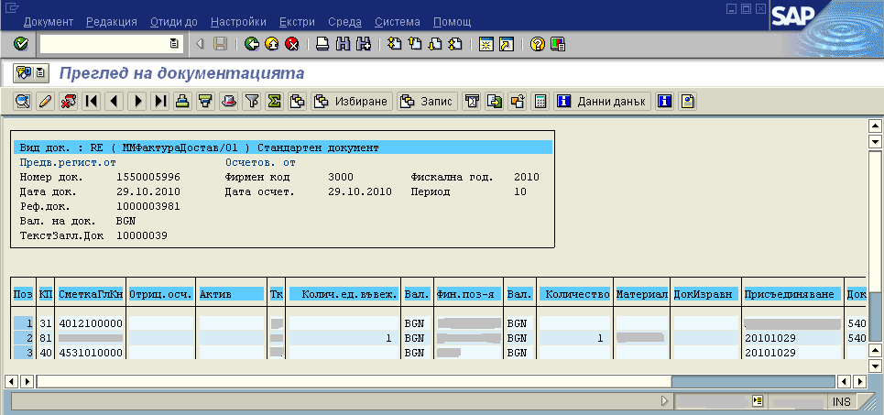
Integration with SAP – Documentum incoming invoices
Documentum Documents Management System
13

Slide 14
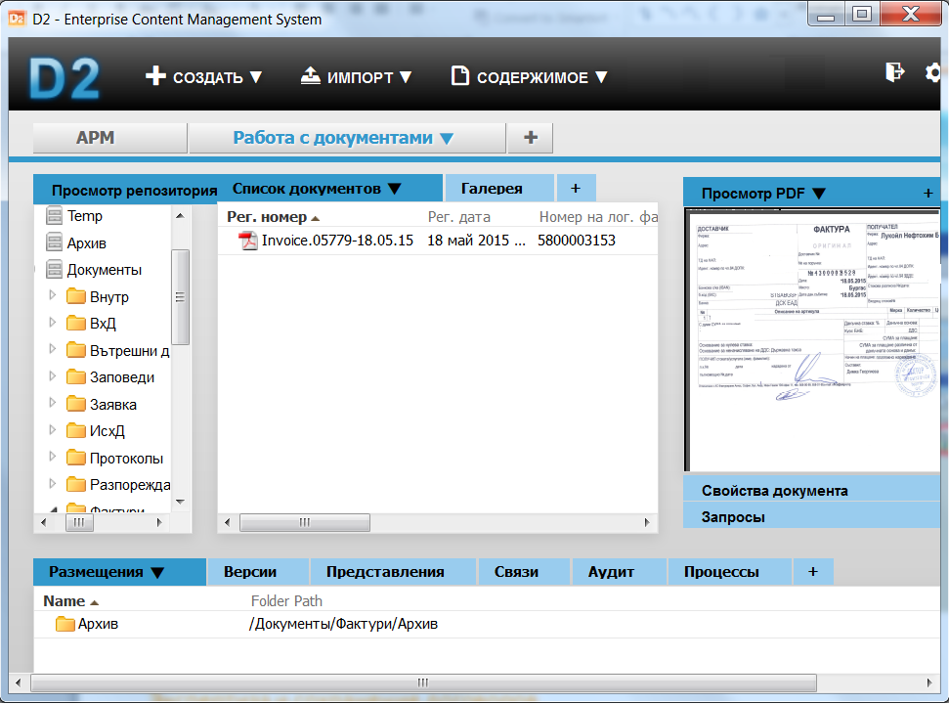
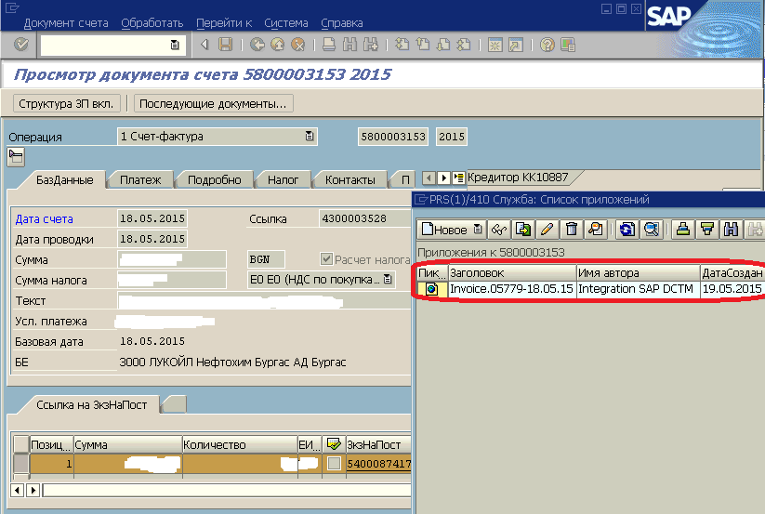
Documentum Documents Management System
Financial document flow for incoming invoices– outsource of accounting functions
Company “X”
Contractor “Y”
Upkeep of standard and tax accounting
Executants in company “X” register the incoming invoices in system Documentum D2.
The funds center supervisors in company “X” agree on the invoices in D2 system.
Integration between the SAP and D2 systems allows for the remote processing of incoming invoices by accountants of company “Y” in the SAP system.
14
14

Slide 15
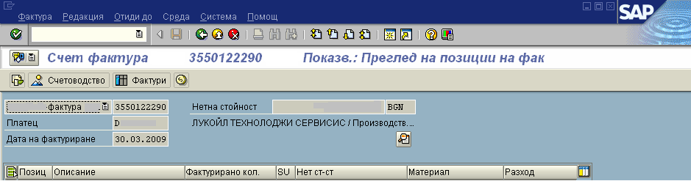
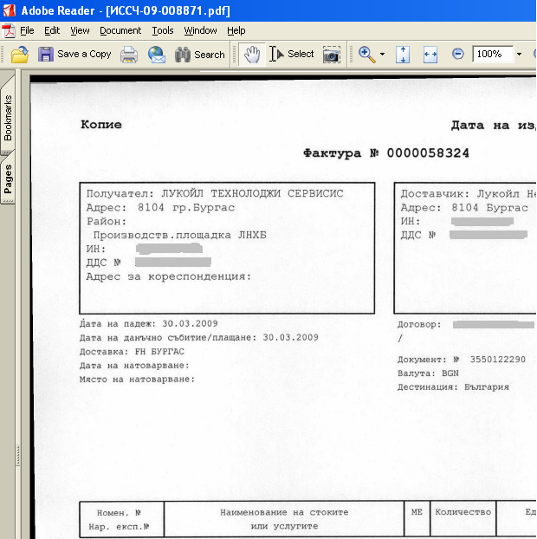
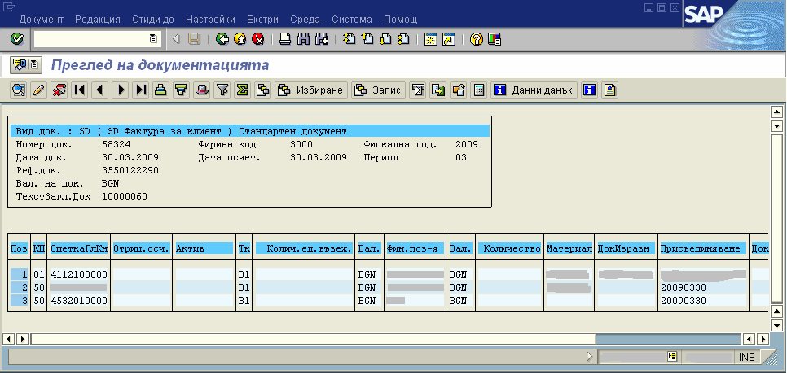
Integration SAP – Documentum outgoing invoices
Documentum Documents Management System
15

Slide 16








EMC DOCUMENTUM OFFERED CLIENTS AND APPLICATIONS
Documentum Documents Management System
MOBILE
DOCUMENTUM MOBILE
FOCUSED CLIENTS
CONFIGURABLE
CLIENTS
ADJUSTABLE/
PROGRAMMABLE
COLLABORATION
PROCESS-CENTRIC
CENTERSTAGE / EROOM
DOCUMENTUM D2
PRODUCT FAMILY
DOCUMENTUM
xCP
DIGITAL ASSET MANGEMENT
MEDIAWORKSPACE
OFFICE INTEGRATION
CONTENT-CENTRIC
MY DOCUMENTUM
WEBTOP
Current version of the platform Documentum 7
DOCUMENTUM PLATFORM
OPTIMIZED FOR THE PRIVATE CLOUD
16

Slide 17

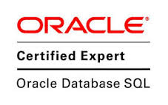



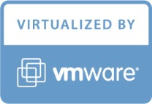

AVAILABLE RESOURCE FOR IMPLEMENTING DOCUMENTUM
Documentum Documents Management System
COMPANY “BUSINESS MANAGEMENT SYSTEMS” HAS HIGHLY QUALIFIED TEAM OF SPECIALISTS WITH EXPIRIENCE IN IMPLEMENTATION AND SUPPORT OF DOCUMENTUM SOLUTIONS.
THE TEAM HAS IMPLEMENTED STANDARD AND SPECIFIC PROJECTS INCLUDING SAP ERP INTEGRATION.
CERTIFIED DOCUMENTUM CONSULTANTS:
2 DEVELOPMENT CONSULTANTS
3 ADMINISTRATION CONSULTANTS
CONSULTANTS BY AREA:
3 CONSULTANTS FOR SUPPORT & ADMINISTRATION
2 CONSULTANTS FOR SOFTWARE ARCHITECTURES
1 CONSULTANT FOR BUSINESS MODELLING
1 CONSULTANT FOR SAP ABAP (INTEGRATION)
2 CONSULTANTS FOR DВ ADMINISTRATION (ОRACLE)
17

Slide 18

Thank you for your attention!
Business Management Systems Ltd.
Business Management Systems Ltd.
Bulgaria Office:
Address: Production Site of Lukoil Neftohim Burgas AD
Post code : 8104 Burgas, Bulgaria
Phone: +359 5511 3337
Fax: +359 898 131
Mail: marina.dimitrova@bmsys.eu

